Slide 1
CpE Qualifying Exam
Secondary paper: Computer Architecture
Neural Cache: Bit-Serial In-Cache Acceleration of Deep Neural Networks
Charles Eckert, Xiaowei Wang, Jingcheng Wang, Arun Subramaniyan,
Ravi Iyer†, Dennis Sylvester, David Blaauw, and Reetuparna Das
2018 ACM/IEEE 45th Annual International Symposium on Computer Architecture
Reviewed and presented by Jingyun Ning (jn2ne@virginia.edu)
CpE Ph.D. student
1

Slide 2
Outline
Introduction
Neural Cache Arithmetic
Neural Cache Architecture
Results
Conclusion and Review

Slide 3
Introduction
Memory wall
Memory hierarchy
Processing-in-memory (PIM): 3D stacking
Increase processing speed and memory transfer rate
Decrease latency and power usage
Significantly increase the cost to the system.
Access Time (increasing)
Storage
(increasing)
Register
Cache
Main memory or RAM
Hard disk
Magnetic Tape
[1] Wulf, Wm A., and Sally A. McKee. "Hitting the memory wall: implications of the obvious." ACM SIGARCH computer architecture news 23.1 (1995): 20-24.
[2] D. Kim, J. Kung, S. Chai, S. Yalamanchili, and S. Mukhopadhyay, “Neurocube: A programmable digital neuromorphic architecture with high-density 3d memory,” in Proceedings of ISCA, vol. 43. IEEE, 2016, pp. 380–392.
2

Slide 4
Neural Cache Objectives
Perform in-cache computation by repurposing the cache structure
Transform CPU into a neural accelerator
Execute DNN in SRAM arrays
3

Slide 5
Outline
Introduction
Neural Cache Arithmetic
Neural Cache Architecture
Results
Conclusion and Review

Slide 6
Bit-Serial Arithmetic
Process the arrays bit-slice by bit-slice
Gain larger throughput than bit-parallel arithmetic
Element 1
bit 1
Element 2
bit 2
A
A
512
….
32-bit
….
Element 512
bit 32
512
32-bit
4

Slide 7
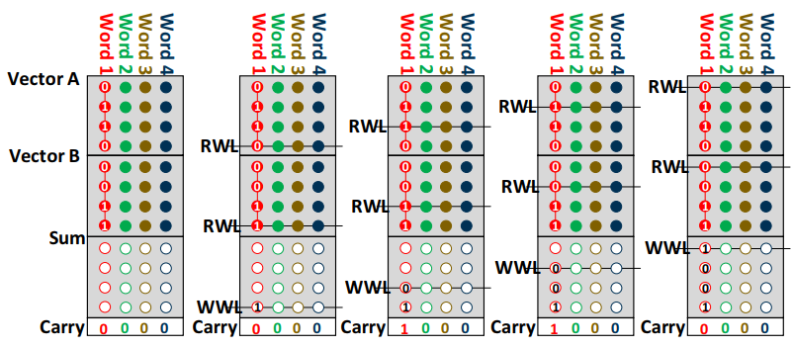
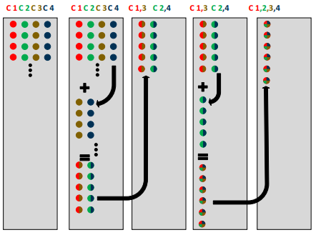
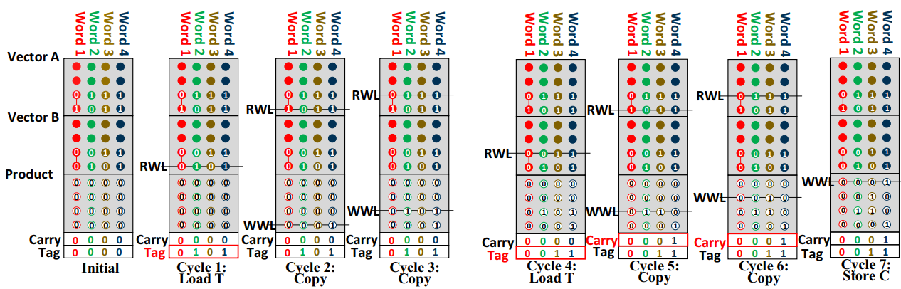
Operations
Addition (a)
Multiplication (b)
Reduction (c)
(a)
(c)
(b)
5

Slide 8
Addition
Word
1 2 3 4
RWL
0
0
0
0
RWL
1
0
0
0
Vector A
RWL
0
0
0
1
RWL
0
1
1
1
RWL
0
0
0
0
Vector B
0
0
1
RWL
1
RWL
1
0
1
0
RWL
0
1
1
0
Sum
WWL
0
0
0
0
WWL
1
1
1
1
WWL
1
1
0
1
WWL
0
0
0
1
Carry
0
0
1
0
0
0
0
0
0
1
1
0
6

Slide 9
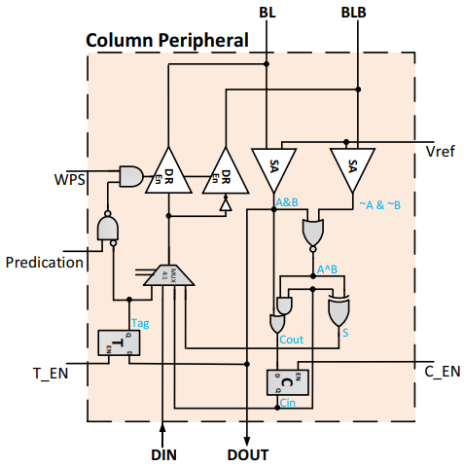
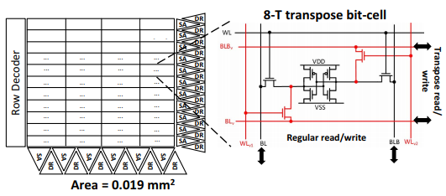
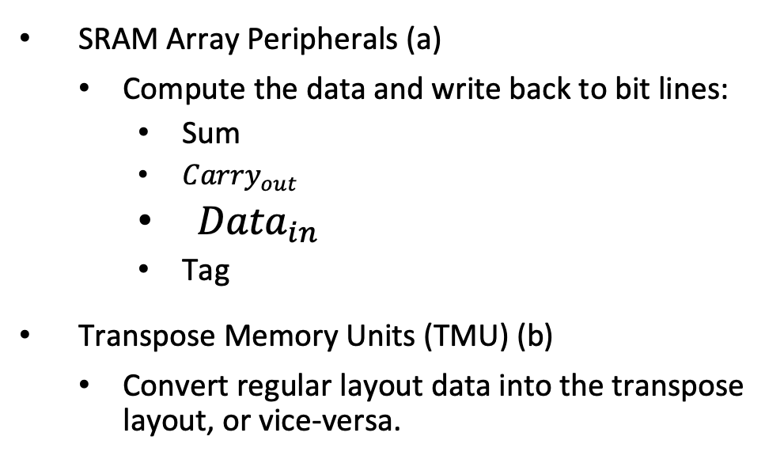
Peripherals
SRAM Array Peripherals (a)
Compute the data and write back to bit lines:
Sum
${Carry}_{out}$
${Data}_{in}$
Tag
Transpose Memory Units (TMU) (b)
Convert regular layout data into the transpose layout, or vice-versa.
(a)
(b)
7

Slide 10
Outline
Introduction
Neural Cache Arithmetic
Neural Cache Architecture
Results
Conclusion and Review

Slide 11
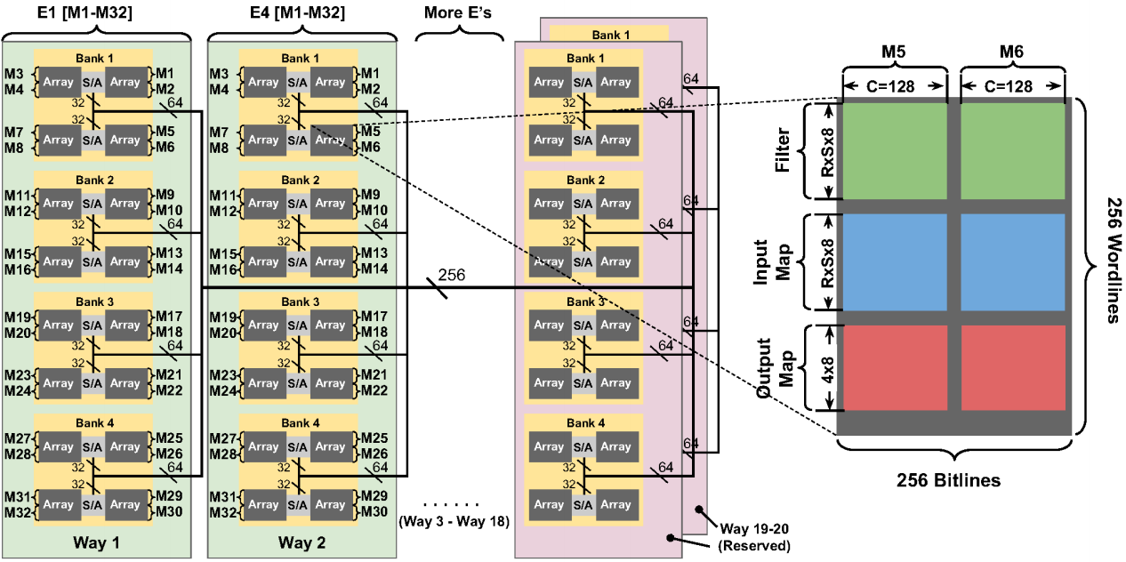
Neural Cache Architecture
Each cache slice has 20 ways (Xeon E5 has 14 slices)
SRAM arrays compute convolutions in parallel
Each slice computes 18 x 32 convolutions in parallel
8
(Figure 9)

Slide 12
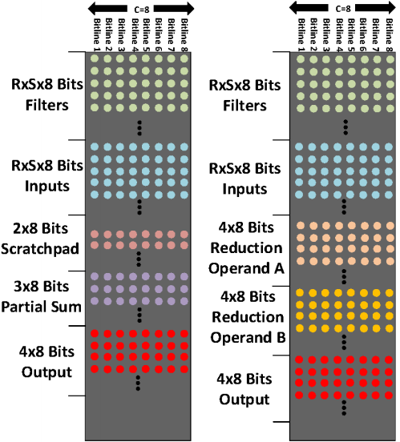
Data Movement
Load filter weights from DRAM
Load input data from DRAM
Perform Multiply and Accumulate (MAC) and reduction operations
Output data transfer to the reserved ways (way 19) in each slice
(Figure 10)
9

Slide 13
Supporting Functions
Max Pooling, Avg Pooling
Quantization
Batch Normalization
Relu
Fully connected
10

Slide 14
Outline
Introduction
Neural Cache Arithmetic
Neural Cache Architecture
Results
Conclusion and Review

Slide 15
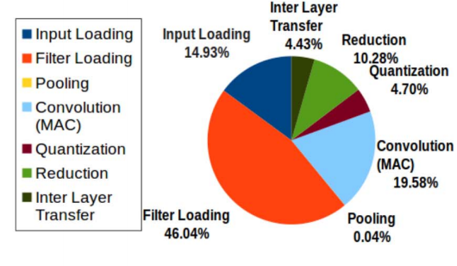
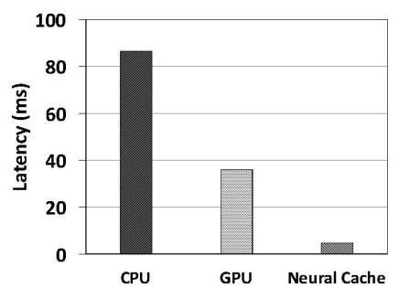
Results
Latency
Neural cache exploits data parallelism across convolution to provide low-latency inference
Running inference on the Inception v3 model.
(Figure 15)
(Figure 14)
11

Slide 16
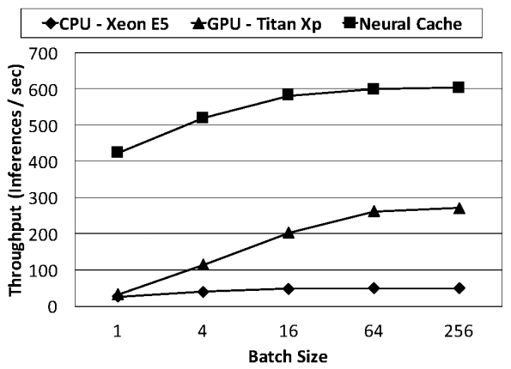
Batching
Neural Cache scales linearly with number of host CPUs
Increase becomes steady because of the effect of amortization of filter loading time diminishes as batching size increases.
12

Slide 17
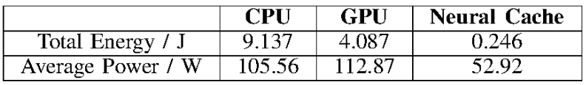
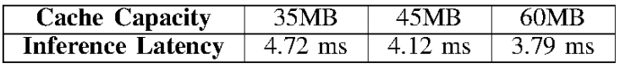
Performances
Power and Energy
Scaling with Cache Capacity
Increase convolutions can be done in parallel
Reduce Input loading time
Fewer inter-layer data transfer
13

Slide 18
Outline
Introduction
Neural Cache Arithmetic
Neural Cache Architecture
Results
Conclusion and Review

Slide 19
Conclusion
Demonstrate in-cache arithmetic compute capabilities for caches
Able to perform additions, multiplications and reductions
Propose bit-serial implementation with transposed data layout
Allow massively parallel compute for Deep Neural Networks.
14

Slide 20
Limitations
Implement Neural Cache on an unusually large 35MB LLC
Lack detailed explanations of support of CNN functions
15

Slide 21
Thank you!

